Slide 1

Software Engineering
Agile Software Development
Assoc prof. dr. Tomas Blažauskas, 2017

Slide 2
Let‘s play...
www.kahoot.it
Notes:
https://www.youtube.com/watch?v=UZq4sZz56qM

Slide 3
Lecture topics
Agile methods
Agile development techniques
Agile project management
Scaling agile methods

Slide 4
Rapid software development
Rapid development and delivery is now often the most important requirement for software systems
Businesses operate in a fast–changing requirement and it is practically impossible to produce a set of stable software requirements
Software has to evolve quickly to reflect changing business needs.
Plan-driven development is essential for some types of system but does not meet these business needs.
Agile development methods emerged in the late 1990s whose aim was to radically reduce the delivery time for working software systems

Slide 5
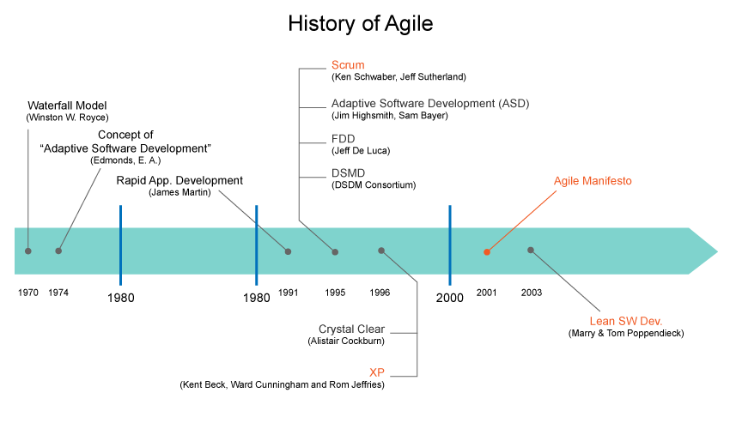
Agile history
https://www.visual-paradigm.com/guide/agile-software-development/what-is-agile-software-development/

Slide 6
Agile development
Program specification, design and implementation are inter-leaved
The system is developed as a series of versions or increments with stakeholders involved in version specification and evaluation
Frequent delivery of new versions for evaluation
Extensive, but as simple as possible tool support (e.g. automated testing tools) used to support development.
Minimal documentation – focus on working code

Slide 7
Plan-driven and agile processes
Plan-driven development
A plan-driven approach to software engineering is based around separate development stages with the outputs to be produced at each of these stages planned in advance.
Not necessarily waterfall model – plan-driven, incremental development is possible
Iteration occurs within activities.
Agile development
Specification, design, implementation and testing are inter-leaved and the outputs from the development process are decided through a process of negotiation during the software development process.

Slide 8
Agile methods

Slide 9
The aim of Agile methods
Dissatisfaction with the overheads involved in software design methods of the 1980s and 1990s led to the creation of agile methods. These methods:
Focus on the code rather than the design
Are based on an iterative approach to software development
Are intended to deliver working software quickly and evolve this quickly to meet changing requirements.
The aim of agile methods is to reduce overheads in the software process (e.g. by limiting documentation) and to be able to respond quickly to changing requirements without excessive rework.

Slide 10
Agile manifesto
We are uncovering better ways of developing software by doing it and helping others do it. Through this work we have come to value:
Individuals and interactions over processes and tools Working software over comprehensive documentation Customer collaboration over contract negotiation Responding to change over following a plan
That is, while there is value in the items on the right, we value the items on the left more.

Slide 11
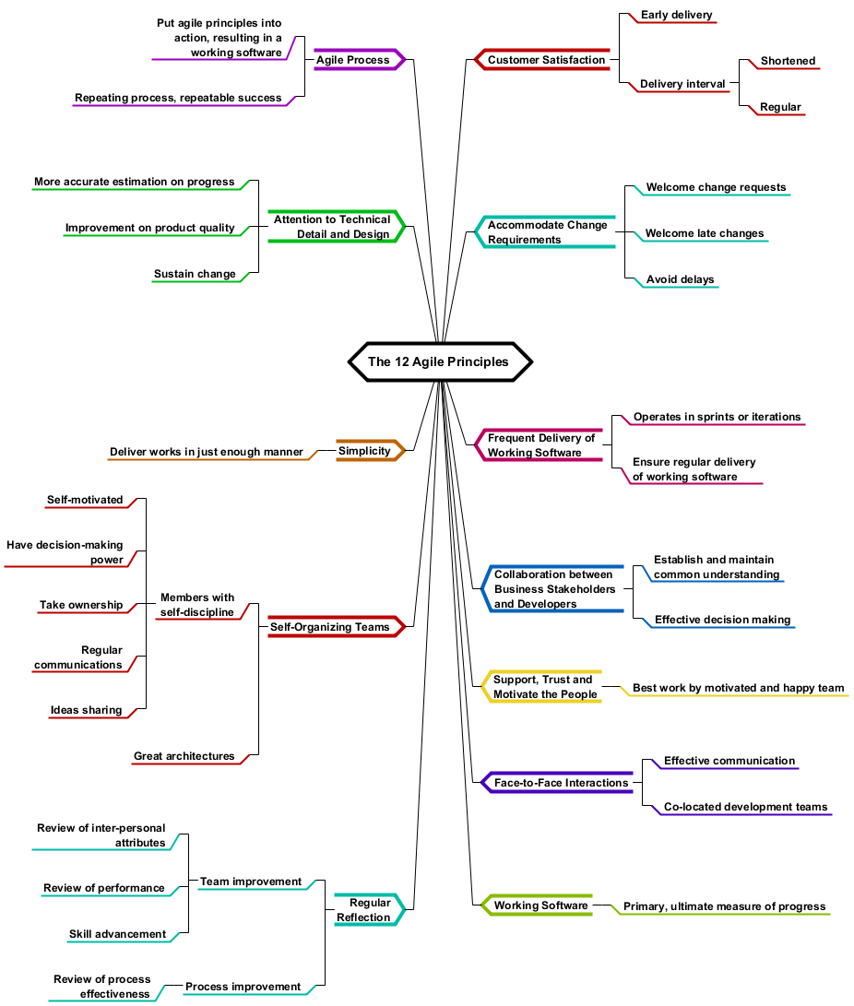
Agile principles (behind manifesto)
Our highest priority is to satisfy the customer through early and continuous delivery of valuable software.
Welcome changing requirements, even late in development. Agile processes harness change for the customer's competitive advantage.
Deliver working software frequently, from a couple of weeks to a couple of months, with a preference to the shorter timescale.
Business people and developers must work together daily throughout the project.
Build projects around motivated individuals. Give them the environment and support they need, and trust them to get the job done.
The most efficient and effective method of conveying information to and within a development team is face-to-face conversation.
Working software is the primary measure of progress.
Agile processes promote sustainable development. The sponsors, developers, and users should be able to maintain a constant pace indefinitely.
Continuous attention to technical excellence and good design enhances agility.
Simplicity--the art of maximizing the amount of work not done--is essential.
The best architectures, requirements, and designs emerge from self-organizing teams.
At regular intervals, the team reflects on how to become more effective, then tunes and adjusts its behavior accordingly.

Slide 12
Agile method applicability
It looks like Agile is designed for product development where a software company is developing a small or medium-sized product.
It is an object of discussion – if Agile methods can be applied for large scale software development.
Look for “Scrum of Scrum”, “LeSS” (Large Scale Scrum), “SAFe” (Scaled Agile Framework), “DAD”, “RAGE” if you are interested in Agile for large scale development.
A paper “A Review of Scaling Agile Methods in Large Software Development” would be useful as well.

Slide 13
Agile development techniques

Slide 14

Extreme Programming (XP)
A very influential agile method, developed in the late 1990s, that introduced a range of agile development techniques.
Extreme Programming (XP) takes an ‘extreme’ approach to iterative development.
New versions may be built several times per day;
Increments are delivered to customers every 2 weeks;
All tests must be run for every build and the build is only accepted if tests run successfully.
Notes:
https://www.youtube.com/watch?v=1FLaxNvmCc8

Slide 15
XP release cycle

Slide 16
XP practices (a)
Principle or practice | Description
Incremental planning | Requirements are recorded on story cards and the stories to be included in a release are determined by the time available and their relative priority. The developers break these stories into development ‘Tasks’.
Small releases | The minimal useful set of functionality that provides business value is developed first. Releases of the system are frequent and incrementally add functionality to the first release.
Simple design | Enough design is carried out to meet the current requirements and no more.
Test-first development | An automated unit test framework is used to write tests for a new piece of functionality before that functionality itself is implemented.
Refactoring | All developers are expected to refactor the code continuously as soon as possible code improvements are found. This keeps the code simple and maintainable.

Slide 17
XP practices (b)
Pair programming | Developers work in pairs, checking each other’s work and providing the support to always do a good job.
Collective ownership | The pairs of developers work on all areas of the system, so that no islands of expertise develop and all the developers take responsibility for all of the code. Anyone can change anything.
Continuous integration | As soon as the work on a task is complete, it is integrated into the whole system. After any such integration, all the unit tests in the system must pass.
Sustainable pace | Large amounts of overtime are not considered acceptable as the net effect is often to reduce code quality and medium term productivity
On-site customer | A representative of the end-user of the system (the customer) should be available full time for the use of the XP team. In an extreme programming process, the customer is a member of the development team and is responsible for bringing system requirements to the team for implementation.

Slide 18
Influential XP practices
Extreme programming has a technical focus and is not easy to integrate with management practice in most organizations.
Consequently, while agile development uses practices from XP, the method as originally defined is not widely used.
Key practices (pushed to extreme)
User stories for specification
Refactoring
Test-first development
Pair programming
Continuous integration
Short iterations

Slide 19

Pair programming

Slide 20
Pair programming
Pair programming involves programmers working in pairs, developing code together.
This helps develop common ownership of code and spreads knowledge across the team.
It serves as an informal review process as each line of code is looked at by more than 1 person.
One person, a driver, writes the code;
Another person, a navigator, inspects the code and propose improvements;
Programmers change the roles after some period of time (let‘s say – 30 minutes)
It encourages refactoring as the whole team can benefit from improving the system code.

Slide 21
Pair programming
In pair programming, programmers sit together at the same computer to develop the software.
Pairs are created dynamically so that all team members work with each other during the development process.
The sharing of knowledge that happens during pair programming is very important as it reduces the overall risks to a project when team members leave.
Pair programming is not necessarily inefficient and there is some evidence that suggests that a pair working together is more efficient than 2 programmers working separately.

Slide 22
Agile project management
SCRUM

Slide 23
Agile project management
The principal responsibility of software project managers is to manage the project so that the software is delivered on time and within the planned budget for the project.
The standard approach to project management is plan-driven. Managers draw up a plan for the project showing what should be delivered, when it should be delivered and who will work on the development of the project deliverables.
Agile project management requires a different approach, which is adapted to incremental development and the practices used in agile methods. One of such methods is Scrum.
Scrum was influenced by incremental product development theory, organizational learning principles and LEAN manufacturing principles.

Slide 24
Scrum
Scrum is an agile method that focuses on managing iterative development rather than specific agile practices.
There are three phases in Scrum.
The initial phase is an outline planning phase where you establish the general objectives for the project and design the software architecture, creation and estimation of initial backlog items.
This is followed by a series of sprint cycles, where each cycle develops an increment of the system.
The project closure phase wraps up the project, completes required documentation such as system help frames and user manuals and assesses the lessons learned from the project.

Slide 25
Scrum promotes
Small teams
Embracing changing requirements
Frequent delivery
Small batches
Enabling product releases on demand

Slide 26
Scrum characteristics
Time boxed activities
Visualization of project metrics, progress, reports
Multi-disciplinary and self-organizing teams
Product development method rather than engineering method describing software development activities
Product continuously built in a series of sprints
Requirements are presented as items in a backlog
Product is continuously tested as it is produced

Slide 27
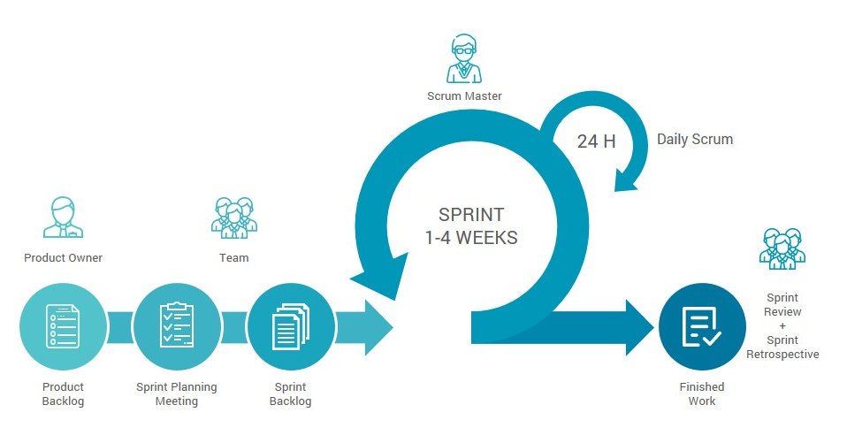
Popular visualizations of Scrum process
1 artifact
2 artifact
3 artifact:
Team velocity

Slide 28
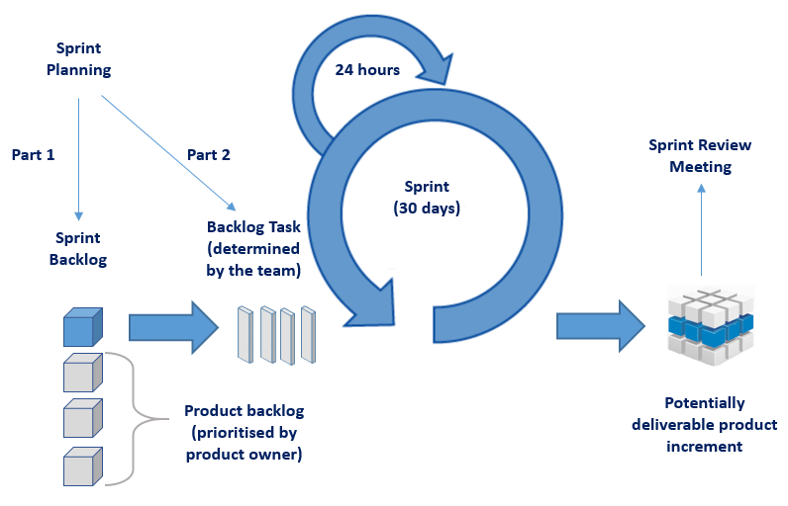
Popular visualizations of Scrum process

Slide 29



Scrum roles
Serves
Serves
Scrum master
Development team
Product owner

Slide 30
Scrum roles

Slide 31
Product owner
Responsible for the value of the product
Defines and prioritizes features of the product in a form of a backlog
Decides release dates and features of the released software
Accepts and rejects iteration results

Slide 32
Development team
7 members +- 2
Multi-disciplinary (everyone required to create quality product)
Self-organizing (teams, its members pull work)
Most of the members working full-time
Team can change only at the end of the sprint

Slide 33

Scrum master
Responsible for enacting Scrum values and practices
Ensures that team is fully functional and productive
Removes impediments
Facilitates team meetings
Ensures cooperation between all roles and members
Shields team from external world
Magic in his hands

Slide 34
Scrum ceremonies
Sprint planning meeting
Sometimes includes estimation and scrum poker
Daily scrum (or stand-up meeting)
Sprint review
Sprint retrospective

Slide 35
Scrum roles

Slide 36
Sprint planning meeting
Define the goal of the sprint
Create sprint backlog
Time boxed (2 hours for 2 week sprint)
Participates Scrum master, product owner and a team
Normally performed Monday, sometimes after retrospective
Team selects items (commits to completing them) and creates sprint backlog
Team eats pizza (optionally)

Slide 37
Daily scrum (or daily stand-up)
Participates team and scrum master
Team is gathering together once per day
Ideally in the morning, at the same time and place each day
Time boxed (15 minutes, standing helps that rule)
Scrum master facilitates meeting
Each team member should answer the kind of questions:
What did you do yesterday?
What will you do today?
What impediments are in your way?

Slide 38
Sprint review (Demo)
Whole team participates as well stakeholder and everyone interested
Team presents what accomplished during a sprint
Only actual work (working software is demonstrated (no powerpoint!))
Time boxed (1.5 hours for 2 week sprint)
Gathering feedback
Celebration
Team selects items (commits to completing them) and creates sprint backlog

Slide 39
Sprint retrospective
Participates the whole team and possibly customers
For the sake of continuous team improvement (Kaizen)
Team discusses what is and is not working
Time boxed (15-30 minutes)
Done after every sprint review
The result is a list of commitments:
What we will start doing?
What we will stop doing?
What we will continue doing?
The commitments (sometimes) are entered as next sprint backlog items
Team celebrates and eats pizza (optionally)

Slide 40
Scrum sprint cycle

Slide 41
The Scrum sprint cycle
Sprints are fixed length, normally 2–4 weeks.
The starting point for planning is the product backlog, which is the list of work to be done on the project created by product owner.
The selection phase involves all of the project team who work with the customer to select the features and functionality from the product backlog to be developed during the sprint.

Slide 42
The Scrum sprint cycle
Once these are agreed, the team organize themselves to develop the software.
Each day team has 1 meeting, the so-called daily scrum or standup meeting.
During this stage the team is isolated from the customer and the organization, with all communications channelled through the so-called ‘Scrum master’.
The role of the Scrum master is to protect the development team from external distractions.
At the end of the sprint, the work done is reviewed and presented to stakeholders. After the review team performs retrospective activities.
The next sprint cycle then begins.

Slide 43
Scrum benefits
The product is broken down into a set of manageable and understandable chunks.
Unstable requirements do not hold up progress.
The whole team have visibility of everything and consequently team communication is improved.
Customers see on-time delivery of increments and gain feedback on how the product works.
Trust between customers and developers is established and a positive culture is created in which everyone expects the project to succeed.

Slide 44
Distributed Scrum

Slide 45
Scrum vocabulary
Scrum term | Definition
Development team | A self-organizing group of software developers, which should be no more than 7 people. They are responsible for developing the software and other essential project documents.
Potentially shippable product increment | The software increment that is delivered from a sprint. The idea is that this should be ‘potentially shippable’ which means that it is in a finished state and no further work, such as testing, is needed to incorporate it into the final product. In practice, this is not always achievable.
Product backlog | This is a list of ‘to do’ items which the Scrum team must tackle. They may be feature definitions for the software, software requirements, user stories or descriptions of supplementary tasks that are needed, such as architecture definition or user documentation.
Product owner | An individual (or possibly a small group) whose job is to identify product features or requirements, prioritize these for development and continuously review the product backlog to ensure that the project continues to meet critical business needs. The Product Owner can be a customer but might also be a product manager in a software company or other stakeholder representative.
Notes:
https://www.youtube.com/watch?v=1H7Ql9hmbuM

Slide 46
Scrum vocabulary
Scrum term | Definition
Scrum | A daily meeting of the Scrum team that reviews progress and prioritizes work to be done that day. Ideally, this should be a short face-to-face meeting that includes the whole team.
ScrumMaster | The ScrumMaster is responsible for ensuring that the Scrum process is followed and guides the team in the effective use of Scrum. He or she is responsible for interfacing with the rest of the company and for ensuring that the Scrum team is not diverted by outside interference. The Scrum developers are adamant that the ScrumMaster should not be thought of as a project manager. Others, however, may not always find it easy to see the difference.
Sprint | A development iteration. Sprints are usually 2-4 weeks long.
Velocity | An estimate of how much product backlog effort that a team can cover in a single sprint. Understanding a team’s velocity helps them estimate what can be covered in a sprint and provides a basis for measuring improving performance.
Notes:
https://www.youtube.com/watch?v=1H7Ql9hmbuM

Slide 47
Agile challenges

Slide 48
Practical problems with agile methods
The informality of agile development is incompatible with the legal approach to contract definition that is commonly used in large companies.
Agile methods are most appropriate for new software development rather than software maintenance. Yet the majority of software costs in large companies come from maintaining their existing software systems.
Agile methods are designed for small co-located teams yet much software development now involves worldwide distributed teams.

Slide 49
Contractual issues
Most software contracts for custom systems are based around a specification, which sets out what has to be implemented by the system developer for the system customer.
However, this precludes interleaving specification and development as is the norm in agile development.
A contract that pays for developer time rather than functionality is required.
However, this is seen as a high risk my many legal departments because what has to be delivered cannot be guaranteed.

Slide 50
Agile methods and software maintenance
Most organizations spend more on maintaining existing software than they do on new software development. So, if agile methods are to be successful, they have to support maintenance as well as original development.
Two key issues:
Are systems that are developed using an agile approach maintainable, given the emphasis in the development process of minimizing formal documentation?
Can agile methods be used effectively for evolving a system in response to customer change requests?
Problems may arise if original development team cannot be maintained.

Slide 51
Agile methods and software maintenance
Key problems are:
Lack of product documentation
Keeping customers involved in the development process
Maintaining the continuity of the development team
Agile development relies on the development team knowing and understanding what has to be done.
For long-lifetime systems, this is a real problem as the original developers will not always work on the system.

Slide 52
Agile principles and organizational practice
Principle | Practice
Customer involvement | This depends on having a customer who is willing and able to spend time with the development team and who can represent all system stakeholders. Often, customer representatives have other demands on their time and cannot play a full part in the software development. Where there are external stakeholders, such as regulators, it is difficult to represent their views to the agile team.
Embrace change | Prioritizing changes can be extremely difficult, especially in systems for which there are many stakeholders. Typically, each stakeholder gives different priorities to different changes.
Incremental delivery | Rapid iterations and short-term planning for development does not always fit in with the longer-term planning cycles of business planning and marketing. Marketing managers may need to know what product features several months in advance to prepare an effective marketing campaign.

Slide 53
Agile principles and organizational practice
Principle | Practice
Maintain simplicity | Under pressure from delivery schedules, team members may not have time to carry out desirable system simplifications.
People not process | Individual team members may not have suitable personalities for the intense involvement that is typical of agile methods, and therefore may not interact well with other team members.

Slide 54
Large system development

Slide 55
Issues
Large systems are usually collections of separate, communicating systems, where separate teams develop each system. Frequently, these teams are working in different places, sometimes in different time zones.
A completely incremental approach to requirements engineering is difficult.
There cannot be a single product owner or customer representative.
For large systems development, it is not possible to focus only on the code of the system.
Cross-team communication mechanisms have to be designed and used.
Continuous integration is difficult to implement. However, it is essential to maintain frequent system builds and regular releases of the system.

Slide 56
Multi-team Scrum
Role replication
Each team has a Product Owner for their work component and Scrum Master.
Product architects
Each team chooses a product architect and these architects collaborate to design and evolve the overall system architecture.
Release alignment
The dates of product releases from each team are aligned so that a demonstrable and complete system is produced.
Scrum of Scrums
There is a daily Scrum of Scrums where representatives from each team meet to discuss progress and plan work to be done.

Slide 57
Further reading (about large system development)
It is an object of discussion – if Agile methods can be applied for large scale software development.
Look for “Scrum of Scrum”, “LeSS” (Large Scale Scrum), “SAFe” (Scaled Agile Framework), “DAD”, “RAGE” if you are interested in Agile for large scale development.
A paper “A Review of Scaling Agile Methods in Large Software Development” would be useful as well.

Slide 58
Key points

Slide 59
Key points
Agile methods are incremental development methods that focus on rapid software development, frequent releases of the software, reducing process overheads by minimizing documentation and producing high-quality code.
Agile development practices include
User stories for system specification
Frequent releases of the software,
Continuous software improvement
Test-first development
Customer participation in the development team.

Slide 60
Key points
Scrum is an agile method that provides a project management framework.
It is centred round a set of sprints, which are fixed time periods when a system increment is developed.
Many practical development methods are a mixture of plan-based and agile development.
Scaling agile methods for large systems is difficult.
Large systems need up-front design and some documentation and organizational practice may conflict with the informality of agile approaches.

